Slide 1
Developing a sensing area visualisation tool for laparoscopic drop-in gamma prob
Supervisor: Prof. Daniel Elson
Group members:
Yiyang Liu
Yiping Li
Wenkang Li
Muhammad Oktavian

Slide 2
Last Week Outline
Marker Detection
Modified Aruco code to adapt calculation and datatype in main code for 3d projection.
Developed feature that can project pose and angle of probe in 3D space
GUI design
Developed the code for display the distance of marker detected
Developed the code for calculating the relative position for two markers
Problems to be discussed:
The shell size is not correct
The area need to be mark for 3D reconstruction

Slide 3
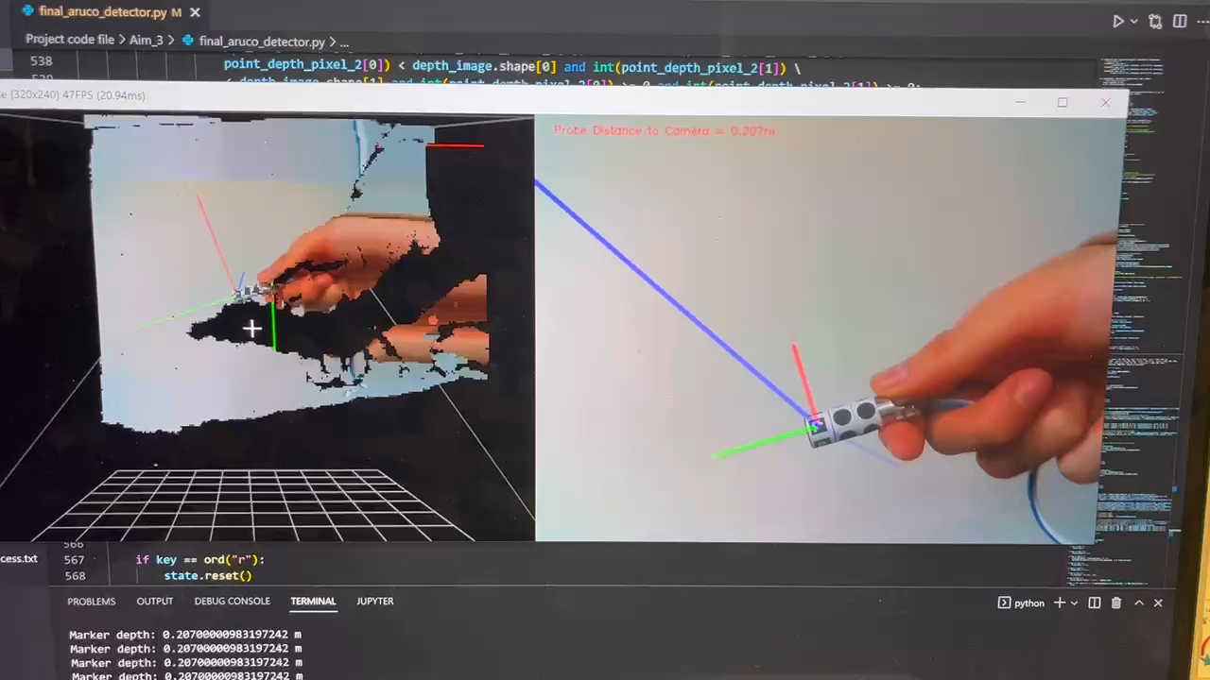

Slide 4
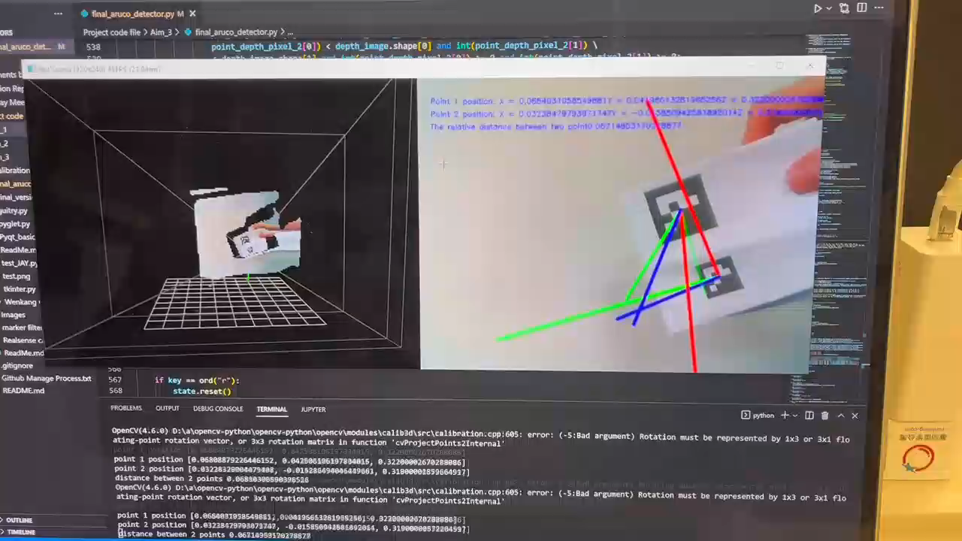

Slide 5
Plan for this week
Draw the probe area in 2D and 3D image
Find more stable shell
Commence the PPT this week

Slide 6
17/11 – 23/11 Log
2022/11/21 2pm-6pm
Project meeting with Prof.Dan
Looked up PPT template
Tried the 150mm lens
2022/11/22 2pm-6pm
Finished the PPT template
Find the Aruco pose axis in color image
Projected the direction axis to 3D space
2022/11/24 10am-1pm
Started the experiment
Checked the value get for depth
2022/11/25 10am-1pm
Continued with the experiment
Analysis the error exist so far

